Slide 1
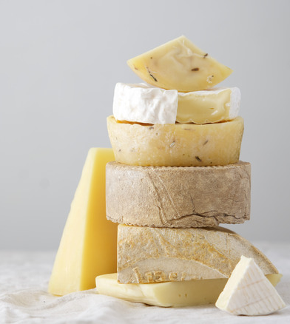
International Cheese Awards
- Interactive Visualization Plan
Group 4:
Kasha Muzila
Karl Eirich
Notes:
Karl: Hello everyone, we are group 4 and this is our midterm presentation on our interactive visualization plan on the international cheese awards

Slide 2
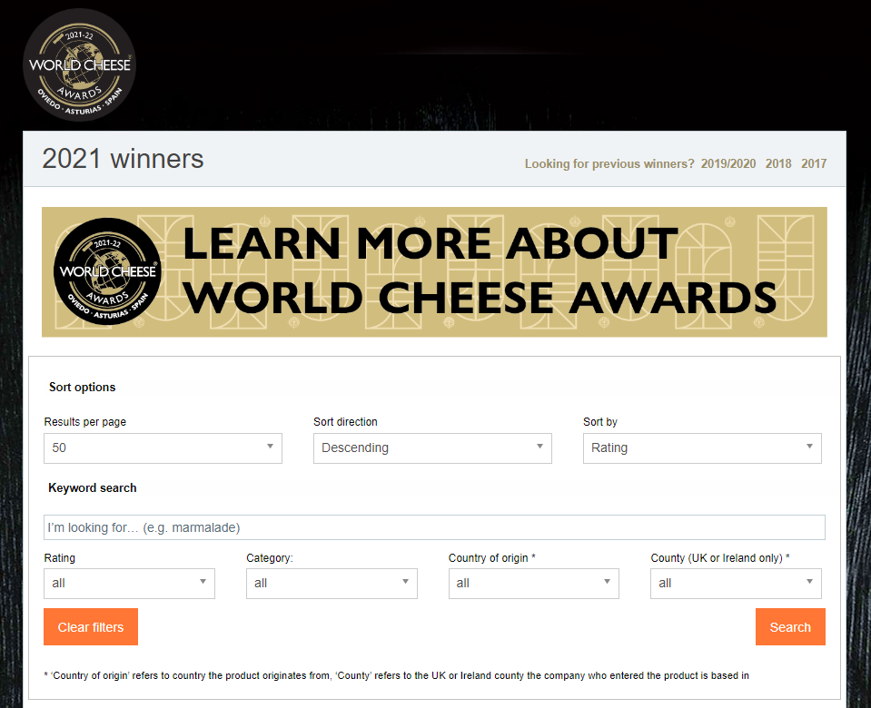
Overview
Visualize results from the 2021 World Cheese Awards
Website includes 1,700 entries:
Companies
Cheese names
Rank
Product name
Category
Country
County
https://worldcheeseawards.com/wca-results
Notes:
Karl: Explain background on dataset, where we got the dataset and what’s in it, why we are analyzing it. Most of this info can be found on the proposal https://docs.google.com/document/d/1mbfLlisNXu9waht0G0rzid7QmGHrB26aHP3tshdGmhA/edit?usp=sharing

Slide 3
Current Code Work
Group server and flask app have been created
Currently working on developing the frontend and adding graphs
We are planning to adding the interactions demonstrated below
Notes:
Karl: Talk about the status of the group server and state that the intention is to implement the interactions below

Slide 4
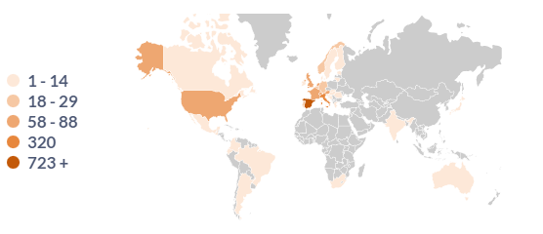

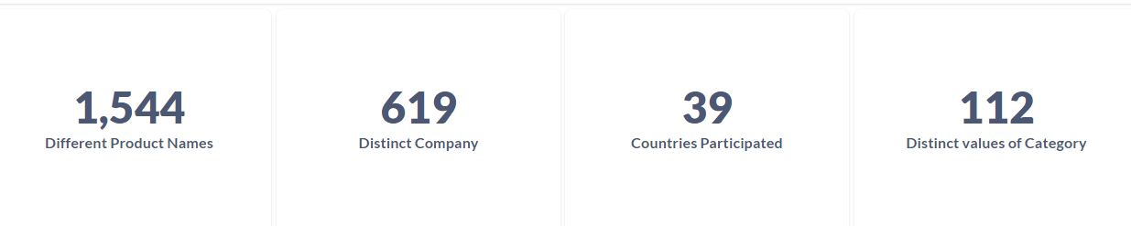
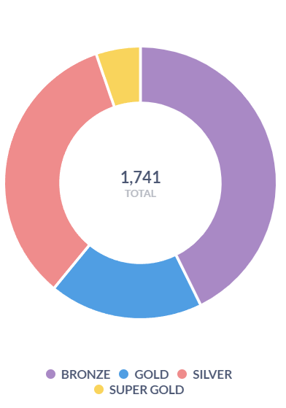
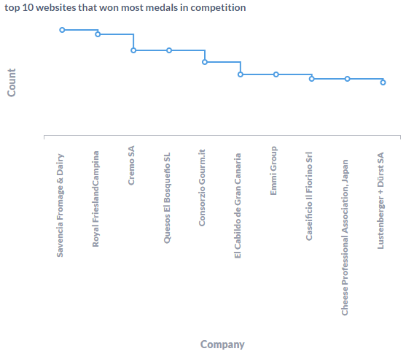
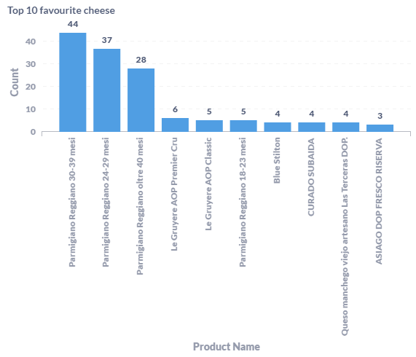
Interactive Dashboard
Notes:
Karl: Want to create an interactive dashboard that will adjust according to the dropdown options using altair and python packages to create the interactive graphs. Ideally, we would like the user to be able to hover over specific parts of these graph to get more information about the data. The initial data displayed will be the entire international cheese awards visualizations that we believe our users will have interest in learning.

Slide 5

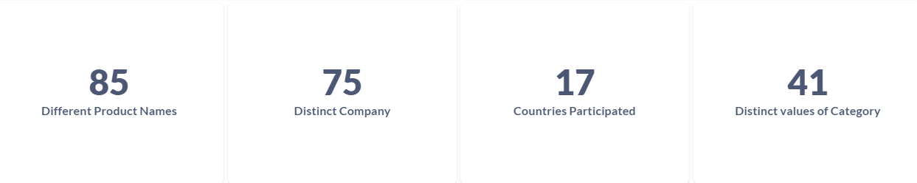
Interactive Dashboard
Notes:
Karl: Example would be changing the rating to Super Gold. Will change the overall international summary to just products, companies, countries, and categories with only Super Gold rating

Slide 6
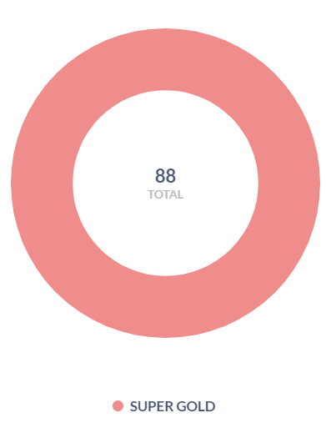
Interactive Dashboard
Notes:
Karl: Pie chart will change from all international ratings and only show the amount of super golds won internationally

Slide 7
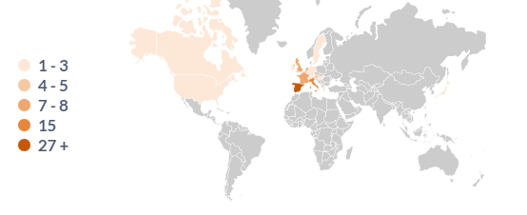
Interactive Dashboard
Notes:
Karl: Geographical map will update to reflect only super gold ratings per country

Slide 8
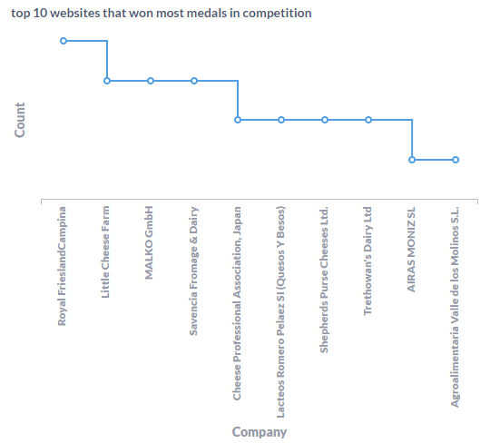
Interactive Dashboard
Notes:
Karl: Top 10 websites will only list the top 10 in super gold rating

Slide 9
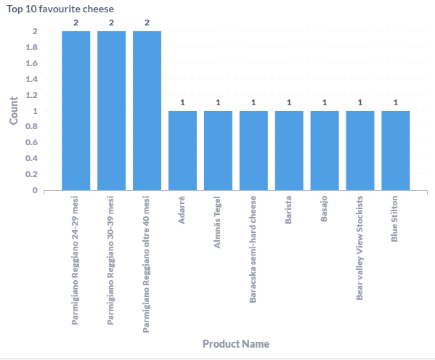
Interactive Dashboard
Notes:
Karl: Top 10 favorite cheeses will only list the top 10 in super gold rating

Slide 10
Interactive Dashboard

Slide 11
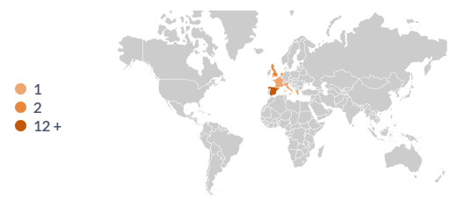
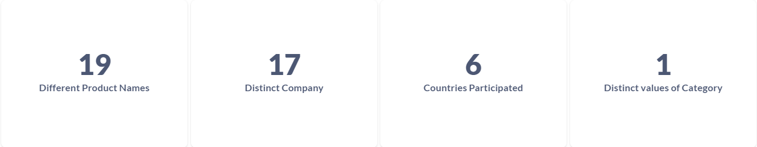
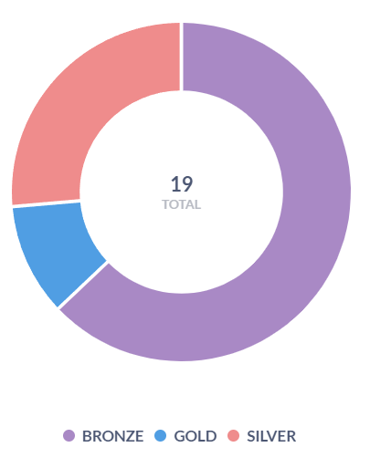
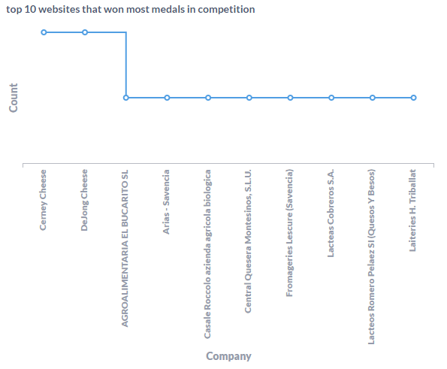
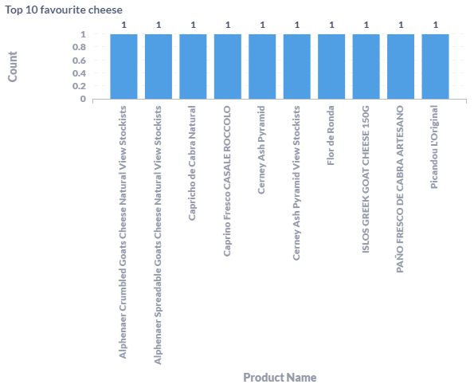
Interactive Dashboard

Slide 12
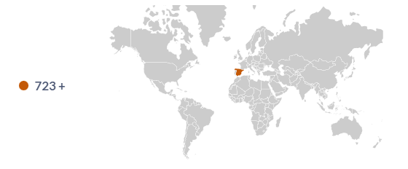
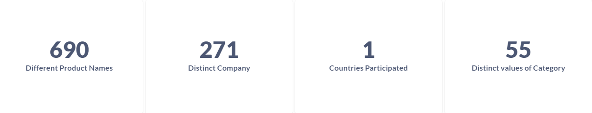
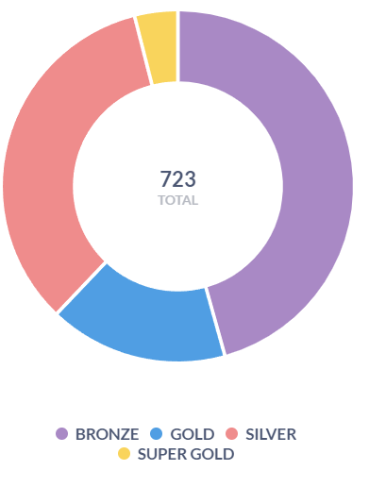
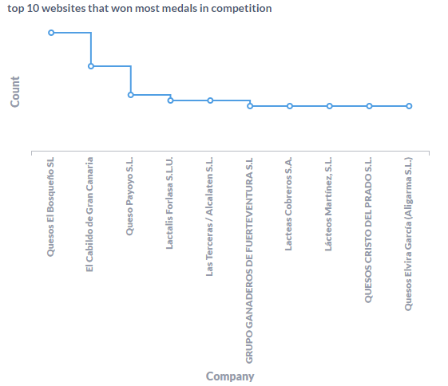
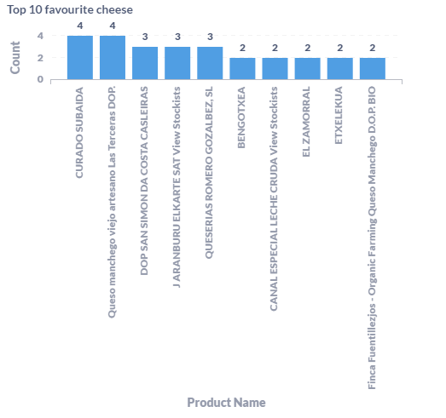
Interactive Dashboard

Slide 13
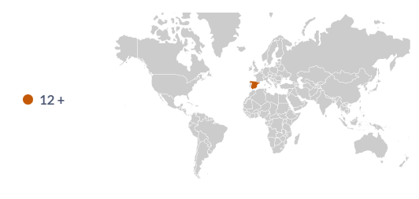
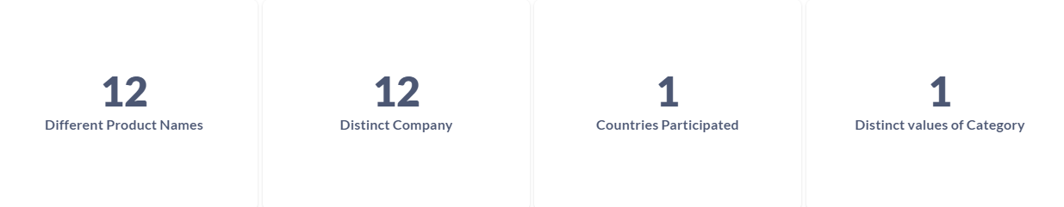
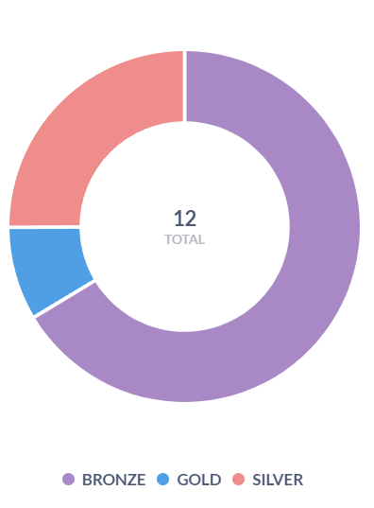
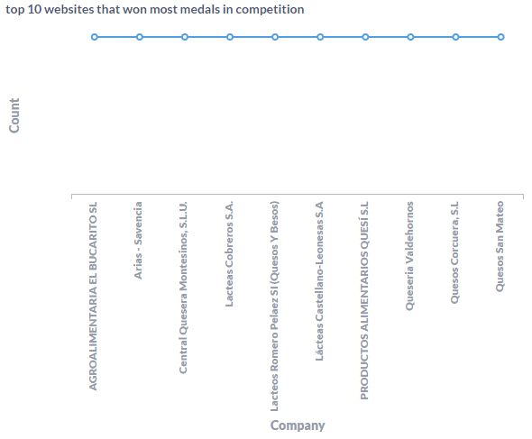
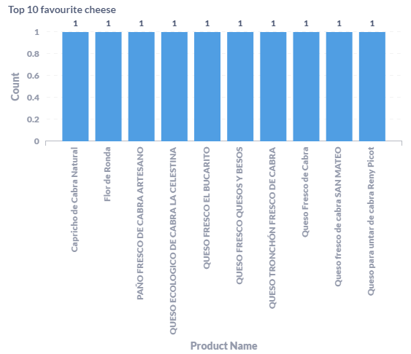
Interactive Dashboard

Slide 14
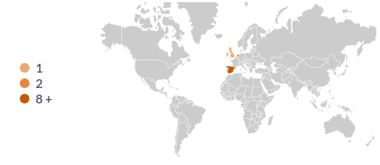
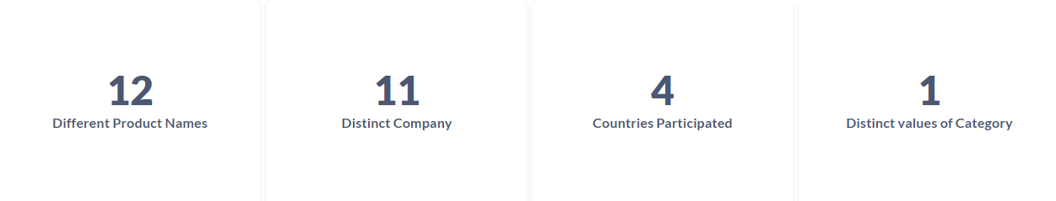
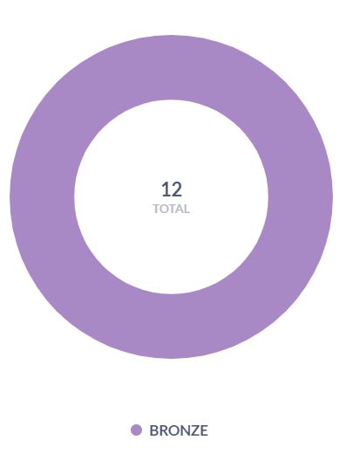
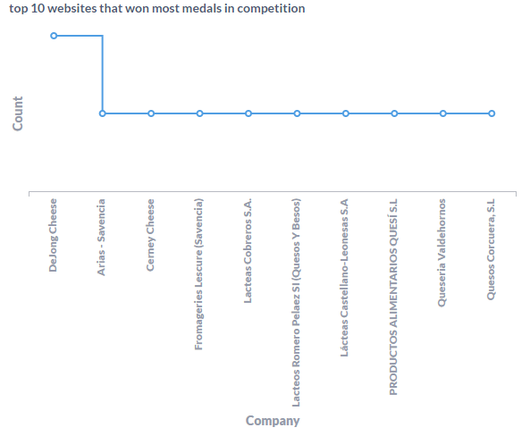
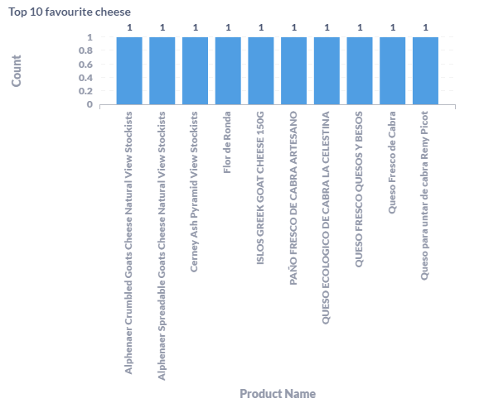
Interactive Dashboard

Slide 15
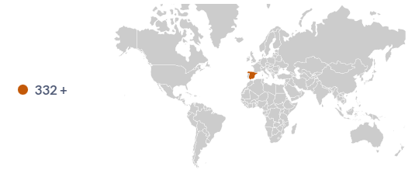

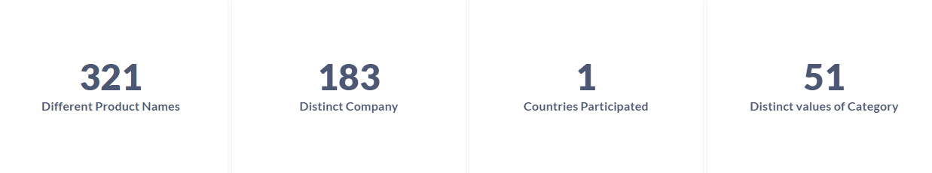
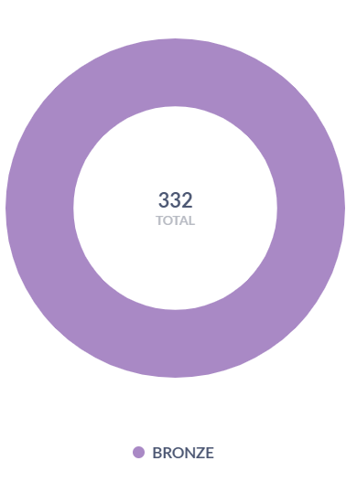
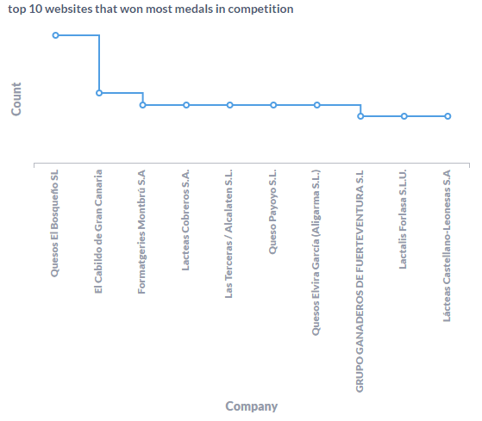
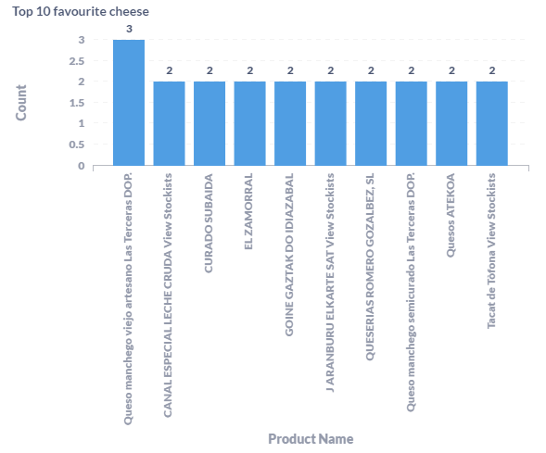
Interactive Dashboard

Slide 16
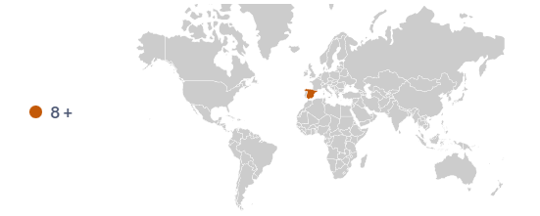
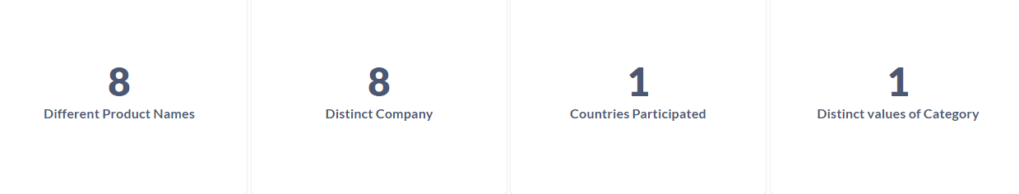
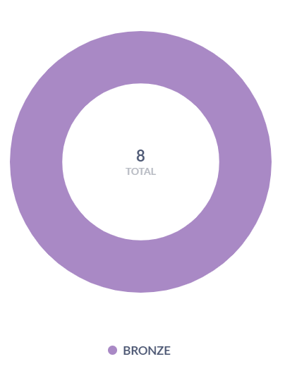
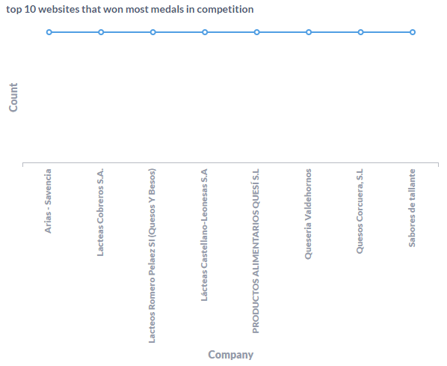
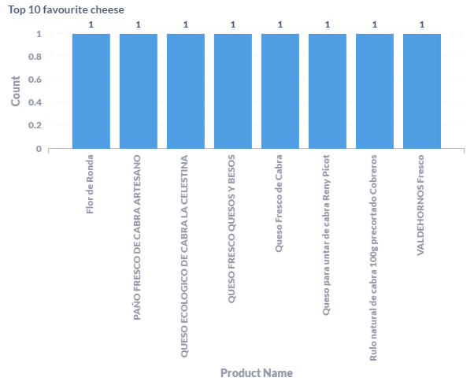
Interactive Dashboard

Slide 17
Thank You
Group 4:
Kasha Muzila - kmuzila@berkeley.edu
Karl Eirich - keirich@berkeley.edu

